Slide 1
Enhancing the Credibility and Accuracy of Health Information Retrieval in Web Search
Guofeng Tang, Gaoyang Qiao, Jianwei Liu
Notes:
Hello everyone. The topic of our group is Enhancing the Credibility and Accuracy of Health Information Retrieval in Web Search. Our group members are me, Tang Guofeng、Gaoyang Qiao and Jianwei Liu

Slide 2
Main Goal
The consequences of insufficient "accuracy" in searches for medical knowledge are greater than those for other searches, and may affect the health of search users. Therefore, we aim to establish a method that can filter out many wrong and unhealthy search results and give a relatively positive answer to the user's question after the search is completed.

Slide 3


Target
URL
Sentence
Answer
Notes:
Our target input is as shown above, which is a question about medical-related content like “Can eye diseases be treated?”. Our target output is that the user gets the URL of a highly relevant article, a core sentence that is highly relevant to the question, and an answer we give to the user's question.

Slide 4
Project Details
General Introduction
According to the introduction in the project goals, our project is mainly divided into the following parts:
Data cleaning
Creating word index
Creating more parameters based on the original word
Calculating document score
Calculating sentence similarity based on Bert
Results and optimization analysis

Slide 5
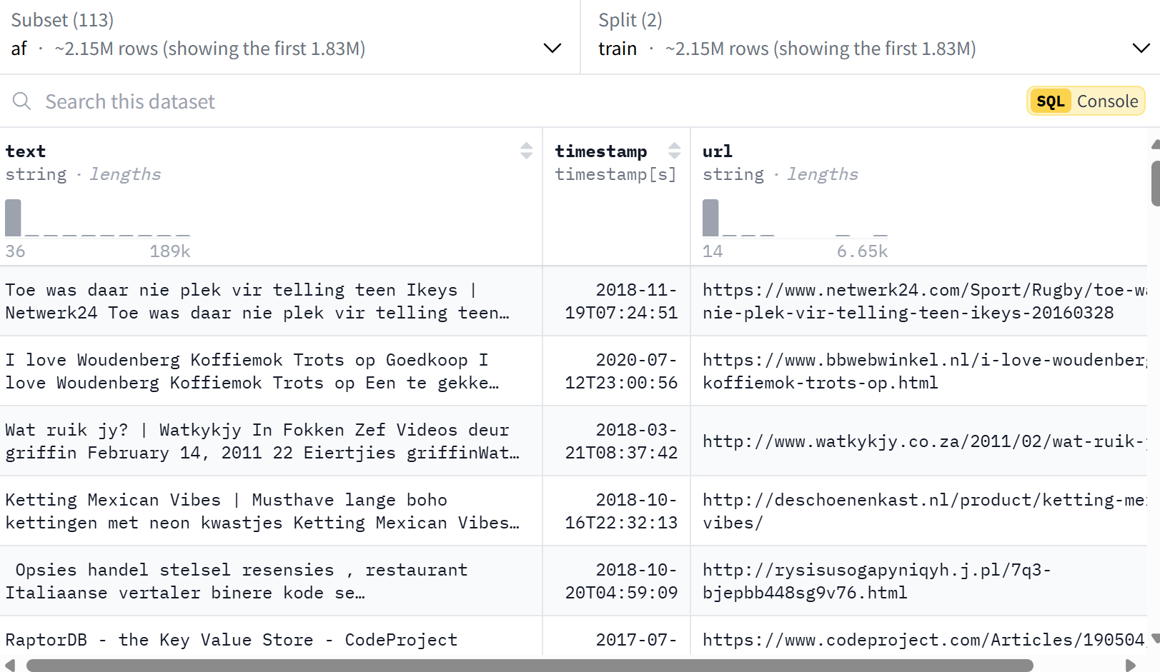
Data Cleaning
https://trec-health-misinfo.github.io/
Notes:
The data we use comes from this website. The content includes: text, which is the content of the webpage article extracted from the webpage; timestamp, which is the timestamp of the webpage; and the URL of the webpage.

Slide 6
Data Cleaning
For this project, we utilized Git LFS to download the dataset. Following the download, we proceeded with several preprocessing steps on the noclean data:
Text Cleaning
Tokenization
Stopword Removal
Stemming
Text cleanning: This includes deleting sensitive words in the original text, deleting unrecognizable symbols, and directly deleting the entire website containing unhealthy content.
Notes:
For this project, we utilized Git LFS to download the dataset. Following the download, we proceeded with several preprocessing steps on the noclean data:
Text Cleaning
Tokenization
Stopword Removal
Stemming
The focus is on text cleaning part. This includes deleting sensitive words in the original text, deleting unrecognizable symbols, and directly deleting the entire website containing unhealthy content.

Slide 7
Creating Index
The index is divided into several parts:
the index of document ID and other related content
the index of document ID and document number
the index of word frequency
the index of document and original content.
Notes:
The index is divided into several parts: the index of document ID and other related content, the index of document ID and document number, the index of word frequency, and the index of document and original content. The second and third are easy to understand and will not be introduced here. The first and fourth will be introduced in detail.

Slide 8
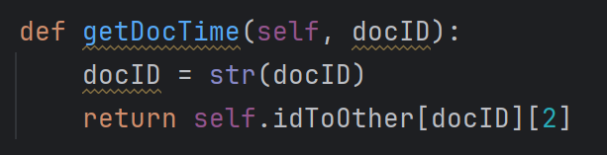
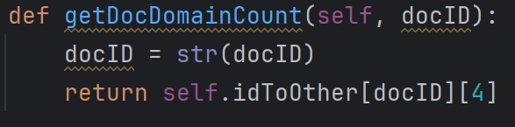
Creating Index
First, the index of document ID and other related content.
Fourth, the document and original content (Due to the inconsistency of document size and data cleaning part, efficiency may be affected).
Notes:
The first is the index of document ID and other related content. Due to the particularity of the acquired data, in addition to basic content such as word frequency and article length, the timestamp of the article is also recorded to indicate the timeliness of the article, and the frequency of occurrence of the web page where the article is recorded is also recorded to indicate the credibility of the source of the article. The fourth is the document and original content. Since this project needs to judge the "correctness" and semantics of part of the article content, it cannot be searched completely by word frequency. Therefore, it is necessary to create a mapping between the article ID and the original text to obtain the original content.

Slide 9
Calculating Document Score
Calculate Relevance Scores:
We used the simple Unigram Language Model and Dirichlet Prior Smoothing as the baseline, but with a twist:
Combine the timestamp and the domainCount as reference to improve the scores.
Select Top N Documents:
Choose the top N most relevant documents for further analysis based on the scores.
Notes:
Next part is calculating document Score. It is divided into two part. First is ….... Second is ……

Slide 10
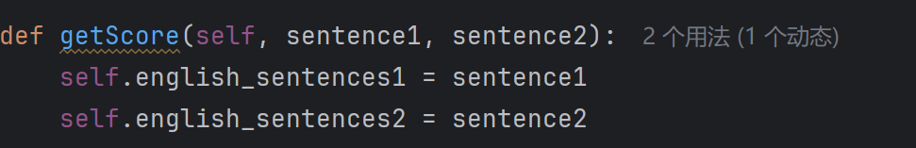
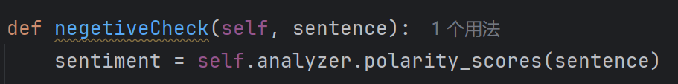
Sentence similarity based on Bert
This part is mainly divided into two parts
Use Bert to judge the similarity of sentences
Use nltk.sentiment to judge the positive or negative nature of sentences
Notes:
The first part is Use Bert to judge the similarity of sentences. One of the parameters is the sentence of the article, and the other parameter is the search content we entered. In this section, we use the Bert tool to find the sentences with the highest semantic similarity in the article for subsequent judgment.
The second part is Use nltk.sentiment to judge the positive or negative nature of sentences. In this part, the input is the article sentences with highest semantic similarity obtained in the previous part. We use this negative Check function to judge the sentiment of the sentence to see whether it is positive or negative. If it is positive, it means that it confirms our query to a certain extent, and we add points. If it is negative, it means that it denies our query to a certain extent, and we deduct points.
Finally, we use the score to determine whether we agree or disagree with the query.

Slide 11
View demo

Slide 12
Summary and Improvement
1. Since the number of articles cleaned up by the article content cleaning part and the article root cleaning part is inconsistent, it is impossible to use the ID to correspond to the document name. If the ID can be used, the running speed of the entire project can be accelerated.
2. Since the document scoring is not detailed enough, more time is needed to determine the sentence similarity. The running speed is too slow.
3. Simply analyzing the positivity and negativity of the sentence cannot completely and accurately determine whether the sentence expresses affirmation or negation. However, we have not yet found a model that can directly judge affirmation or negation.

Slide 13
Team project task division
Gaoyang Qiao: Data Cleaning, Data cleaning introduction PPT content. Preliminary report preparation.
Jianwei Liu: Score Relevance of query results, and rank. Document Scoring introduction PPT content. Mid-term report preparation.
Guofeng Tang: Document content cleaning, Setting data index, Find projects using related models, Calculate the correctness of the input "query content". The rest part of PPT content. Final report preparation.

Slide 14
Demo part introduction(word version)

Slide 15
Demo: Data Cleaning
To facilitate the preprocessing tasks, two Python scripts were developed:
add_docno.py: This script assigns a unique document number (docno) field to each document within the dataset.
data_preprocess.py: It carries out the preprocessing operations outlined in the previous section on the noclean data.
Notes:
To facilitate the preprocessing tasks, two Python scripts were developed:
add_docno.py: This script assigns a unique document number (docno) field to each document within the dataset.
data_preprocess.py: It carries out the preprocessing operations outlined in the previous section on the noclean data.

Slide 16
Creating Index
The main code to complete this part is located in MyIndexWriter.py and ContentWriter.py
In MyIndexWriter, we first process the domain name. For the convenience of counting and observation, we only extract the front part of the web page. The index function is used to create the index file and extract the timestamp. The countDomain function is used to classify the professionalism of the web page by counting the web pages that appear here. And classify, calculate and output in Reader.
In ContentWriter, a simple document content cleaning is performed (to ensure the integrity of the article, stop words cannot be cleared and tokenization cannot be performed), and then the document NO is matched and indexed.
Notes:
Next is Creating Index. The main code to complete this part is located in MyIndexWriter.py and ContentWriter.py
In MyIndexWriter, we first process the domain name. For the convenience of counting and observation, we only extract the front part of the web page. The index function is used to create the index file and extract the timestamp. The countDomain function is used to classify the professionalism of the web page by counting the web pages that appear here. And classify, calculate and output in Reader.
In ContentWriter, a simple document content cleaning is performed (to ensure the integrity of the article, stop words cannot be cleared), and then the document NO is matched and indexed.

Slide 17
scoring
In theory, we should implement the following steps:
Step1: Calculate the original score, just like what we did in the homework3.
Step2: Calculate the topK=100 ranking using timestamp(publish time) and domainCount(confidence) extracted from the dataset to rank the data. Due to time restriction we can’t do grid search as we intended, we set portion of timestamp as 0.2 and domainCount as 0.8.
Step3: Calculate the reference score like we did in homework4
Step4: Combine the original score and reference score together. Here the alpha controls the portion of the scores, we used 0.7 for original and 0.3 for reference.
Step5: Ranking based one the final scores.
Unfortunately, however, the current scoring does not yet use enough parameters.
Notes:
In theory, we should implement the following steps:
Step1: Calculate the original score, just like what we did in the homework3.
Step2: Calculate the topK=100 ranking using timestamp(publish time) and domainCount(confidence) extracted from the dataset to rank the data. Due to time restriction we can’t do grid search as we intended, we set portion of timestamp as 0.2 and domainCount as 0.8.
Step3: Calculate the reference score like we did in homework4
Step4: Combine the original score and reference score together. Here the alpha controls the portion of the scores, we used 0.7 for original and 0.3 for reference.
Step5: Ranking based one the final scores.
Unfortunately, however, the current scoring does not yet use enough parameters.

Slide 18
Bert
In the CheckwithBert file, the getScore() function gets sentences one and two in the input and calls the other two functions to get the scores. The final return is a list of scores for the query content and each sentence in the article. The similarity() function uses bert to get the similarity score of two sentence groups. The negetiveCheck() function uses nltk to determine the sentiment of the input sentence.

Slide 19
Output
In the output, in addition to calling the checkWithBert and relevanceRank files, score determination and correctness determination are performed (the two results come from the two functions in the checkWithBert file).
In the final output, we output the document number, document website, document score, similarity with the query content, and the sentence with the highest similarity. Finally, a correctness feedback on the query content is given.

